Slide 1
Denver Broncos
Is this the year they win it all?

Slide 2
A fan since birth
Born with football in hand
Grew up watching Denver
Pretended I was on team
Dress up every Sunday

Slide 3
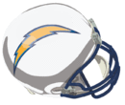
Bleeding Orange and Blue
Faithful fans reject Division Rivals!

Slide 4
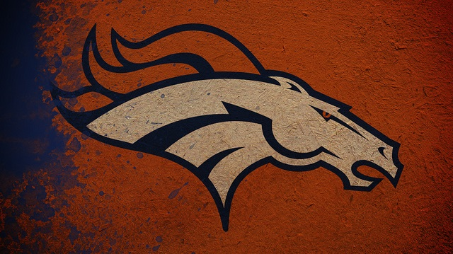
Denver’s Success
Denver has a storied legacy
Won 2 NFL Super Bowls
Won 7 AFC Conference Championships
Their last Championship was in 1998
Many say they’ll win this year

Slide 5
So…
Are they as good as 98’ team?

Slide 6
1998 vs. 2014
Denver Broncos | 1998 | 2014
Offense Rank | 3rd | 4th
Defense Rank | 12th | 4th
Conference Seed | 1st | 2nd
*2014 has 3 games remaining. So potential record is 13-3.

Slide 7
So will they win it all?
Winning it all
Little help from the man upstairs; He is a Broncos fan!
A good offense to put points on the board!
A good defense to keep the other teams’ points off the board!
Loyal fans to say the prayers!

Slide 8
What will you do?
Abandon your old team!
Repent thoroughly and pray for guidance!
Realize the Broncos are where you should have been all along!
Will you convert to the truth?
Bronco fans are loyal = family!
Bronco fans weather it all!
Bronco fans are the best!
Join us!
Be a winner!

Slide 9
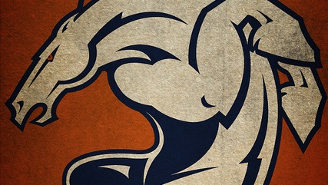
Hope you were amused!
The Denver Broncos statistics and pictures were obtained through the team’s official website: http://www.denverbroncos.com/

Slide 10
The End!
Go Broncos!

