Slide 1
Conserve
Waterwise Landscaping

Slide 2
Purpose of Landscaping
Beauty
Utility
Conservation
Notes:
With water becoming a limited resource, conservation has become a third purpose of landscaping.

Slide 3
Waterwise Options
Zeroscaping
Xeriscaping
Wildfire Aware Options
Defensible landscaping
Zoning

Slide 4
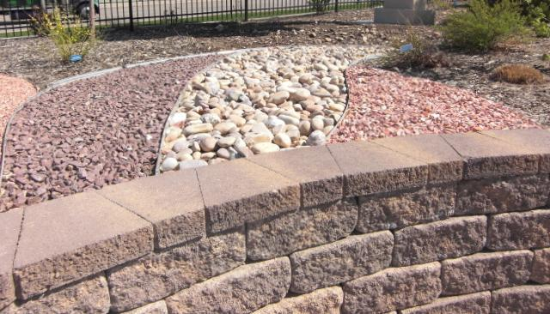
Zeroscaping
Low to No Maintenance Landscaping Design

Slide 5
Characteristics
Uses a variety of rocks for design
Sparse use of drought resistant plants
Relies on rainwater or limited watering

Slide 6
Benefits
Conserves water
Saves $$$
Low maintenance
Presents minimal pest and disease problems
Saves landfill space

Slide 7
Disadvantages
Scarcity of plant life
Possibility of unattractive aesthetic quality

Slide 8
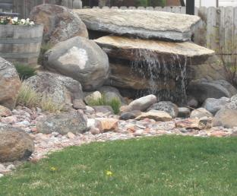
Xeriscaping
Water –Conservative Approach to Landscaping
Notes:
Xeriscaping is created by the combination of the Greek word Xeros (dry) with landscaping. Term coined by the Front Range Xeriscape Task Force of the Denver Water Department in 1981.

Slide 9
Characteristics
Uses a variety of rocks for design
Sparse use of drought resistant plants
Relies on rainwater or limited watering

Slide 10
Benefits
Conserves water
Provides attractive planning options
Presents minimal pest and disease problems
Requires low pruning and maintenance
Saves landfill space

Slide 11
Disadvantages
None!
Initial cost is offset by future savings

Slide 12
“Fire Aware” Landscaping
10’
10’
30’
Zone 1
Zone 2
Zone 3
Notes:
Wildfire is a common threat and natural occurrence. Maintaining an appropriate defensible space around your home is essential. Zone 1: Clear trees within 30 feet of your home and create hardscaped surfaces such as patios and walkways to create a fire resistant buffer. Avoid wooden decks and stacking firewood close to your home. Zone 2: Thin shrubs and trees in the 10 foot wide zone. Remaining trees should be pruned to 10 feet above ground. Zone 3: Keep grasses mown low between trees for at least 10 feet.

Slide 13
Principles of Waterwise Landscaping
Tips from the Office of Community Services, Fort Lewis College
Develop Landscape Plan
Condition Your Soil
Limit Lawn Size

