Slide 1
Conserve
Waterwise Landscaping

Slide 2
Purpose of Landscaping
Beauty
Utility
Conservation
Notes:
With water becoming a limited resource, conservation has become an additional purpose of landscaping.

Slide 3
Waterwise Options
Zeroscaping
Xeriscaping

Slide 4
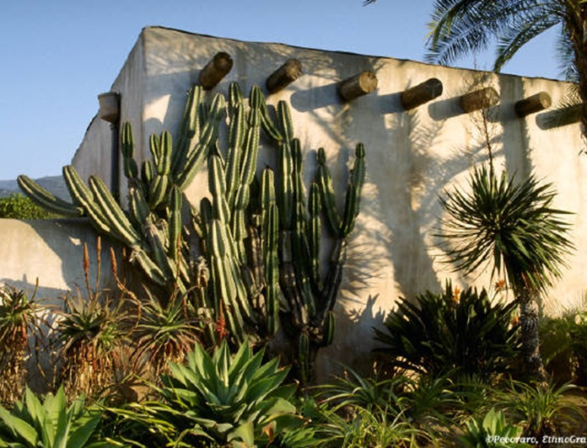
Zeroscaping
Low to No Maintenance Landscaping Design

Slide 5
Characteristics
Uses a variety of rocks for design
Sparse use of drought resistant plants
Relies on rainwater or limited watering

Slide 6
Benefits
Conserves water
Saves $$$
Low maintenance
Presents minimal pest and disease problems
Saves landfill space

Slide 7
Disadvantages
Scarcity of plant life
Possibility of unattractive aesthetic quality

Slide 8
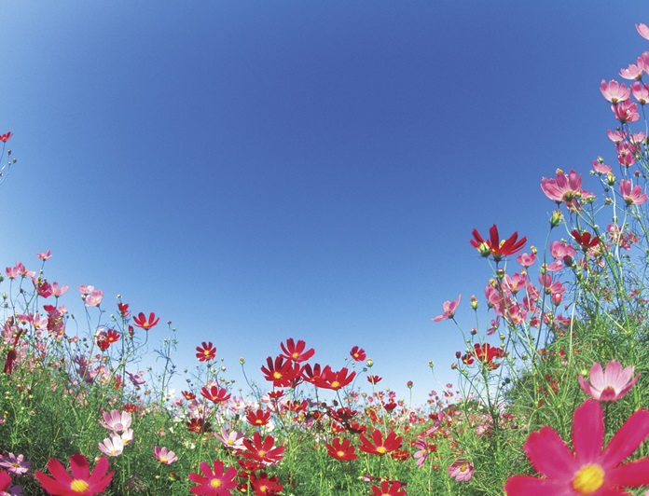
Xeriscaping
Water –Conservative Approach to Landscaping
Notes:
Xeriscaping is created by the combination of the Greek word Xeros (dry) with landscaping. Term coined by the Front Range Xeriscape Task Force of the Denver Water Department in 1981.

Slide 9
Characteristics
Uses a variety of rocks for design
Sparse use of drought resistant plants
Relies on rainwater or limited watering

Slide 10
Benefits
Conserves water
Provides attractive planning options
Presents minimal pest and disease problems
Requires low pruning and maintenance
Saves landfill space

Slide 11
Disadvantages
None!
Initial cost is offset by future savings

